Slide 1
I know my top 5 strengths. Now what?
http://collaborativeleadershipteam.com
teri@coleadteam.com

Slide 2
Introductions
Find a photo that resonates with a strength of yours
Share your name and why you picked that photo to your table
5 Minutes
© Collaborative Leadership Team 2019

Slide 3
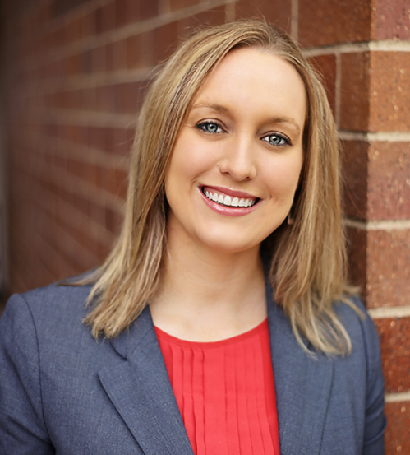
Your Instructor
Teri Bylander-Pinke
Gallup Certified Strengths Coach
Significance
Relator
Learner
Maximizer
Focus
© Collaborative Leadership Team 2019

Slide 4
© Collaborative Leadership Team 2019

Slide 5
Stand up if you always…
Talk to people in elevators, airplanes, grocery stores, and everywhere else you go
Have a color coded or otherwise organized closet
Keep a to-do list and stick to it
Find someone to race while driving
Push the elevator button to “remind” the elevator that you are still there
© Collaborative Leadership Team 2019

Slide 6
Talents v Strengths
Talent
Naturally occurring pattern of thought, feeling, or behavior that can be productively applied.
Strength
The ability to consistently produce a positive outcome through near perfect performance with a specific task.
Talent x Investment = Strength
Notes:
Investment is building skills and knowledge and then practicing.

Slide 7
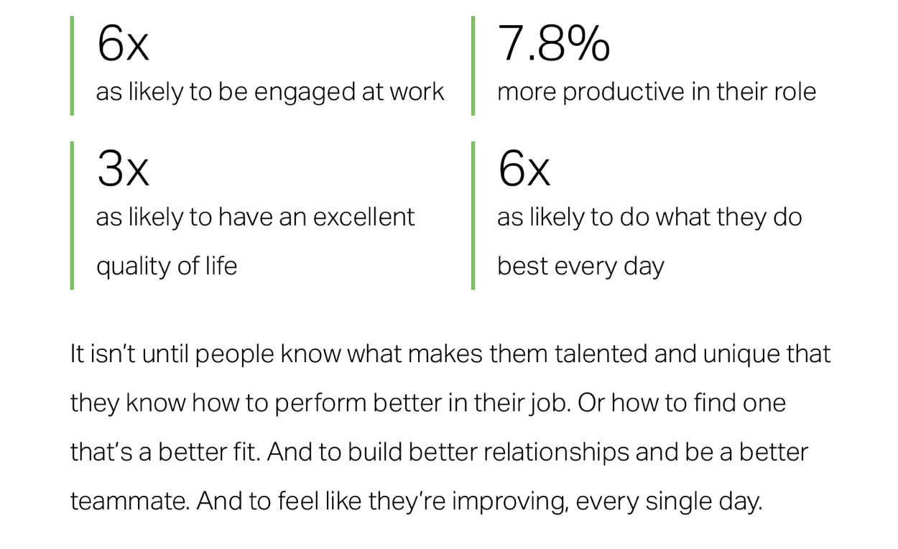
People that use their strengths everyday are…
© Gallup, Inc.

Slide 8
Strengths v Themes
Communication
Written
Verbal

Slide 9
Guiding Principles
Themes are neutral
Themes are not labels
Lead with positive intent
Differences are advantages
People need one another
© Collaborative Leadership Team 2019

Slide 10
Identify your themes
Does everyone know your themes?
If not take 5 minutes to look at the lists on your tables and identify a few that sound like you.
In the future you can take the assessment here…https://store.gallup.com/c/en-us/assessments
5 Clues to Talent
Yearning
Rapid Learning
Flow
Glimpses of Excellence
Satisfaction
5 Minutes
© Collaborative Leadership Team 2019
Notes:
Yearning – naturally drawn to
Rapid Learning – pick up quickly
Flow – automatically know what to do
Glimpses of Excellence – how did I do that?
Satisfaction – when can I do that again?

Slide 11
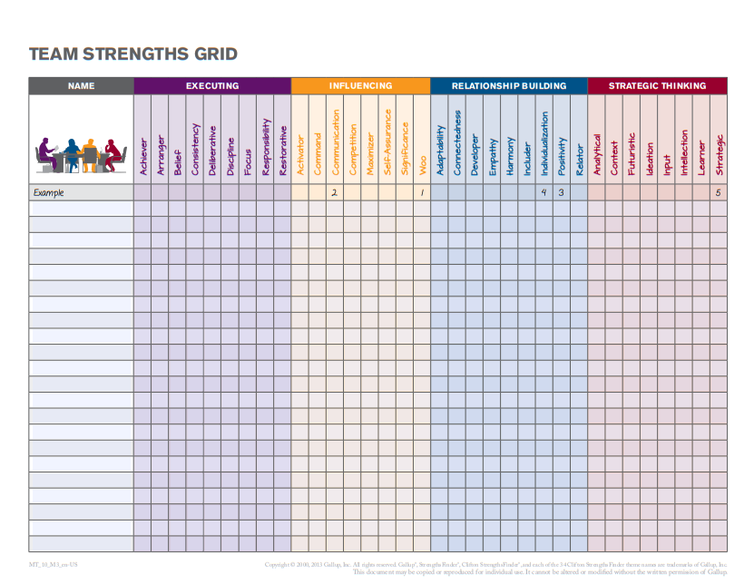
© Gallup, Inc.

Slide 12
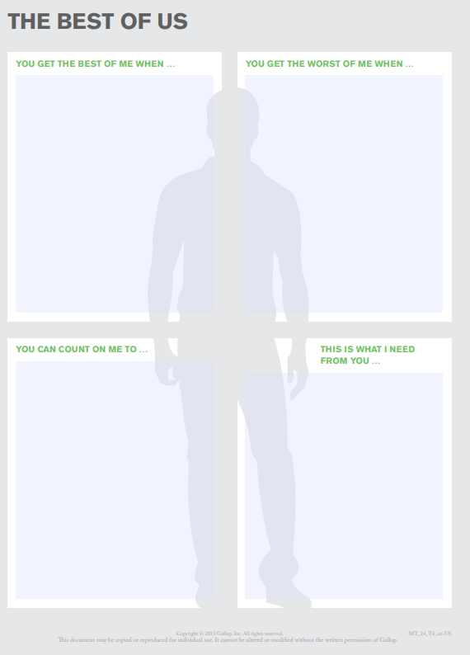
The Best of Me
Create and fill out your form… 5 minutes
Speed dating…1 minute per person, 2 minutes per round
© Gallup, Inc.
15 Minutes

Slide 13
Your team needs to…
Analyze data
Create ago forward plan recommendation
Create a presentation for leadership
Give a presentation to leadership
Go out and sell your plan or idea
5 Minutes
© Collaborative Leadership Team 2019

Slide 14
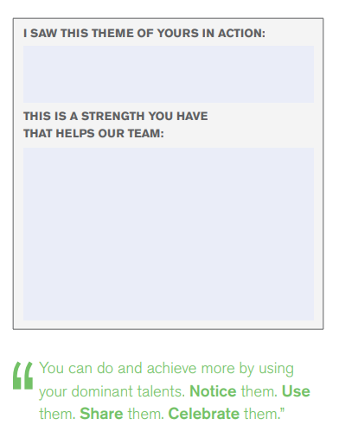
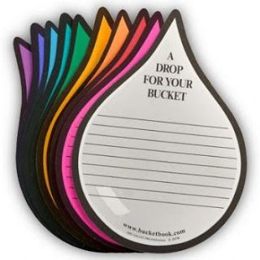
2 Other Ideas
Talents in Action Cards
Drops in Your Bucket
© Gallup, Inc.

Slide 15
Questions?
© Collaborative Leadership Team 2019

Slide 16
Thank you for participating
GREEN: Great Session – Enjoyed It!
(Drop GREEN card in basket)
YELLOW: OK – Missed Mark a Bit for Me
(Drop YELLOW card in basket)
RED: Needs Improving – Will Give Feedback
(Write feedback on RED card and drop in white box)
ONLY WRITE ON CARD IF YOU LEAVE RED FOR FEEDBACK
© Collaborative Leadership Team 2019

